Slide 1

Video game sales

Slide 2
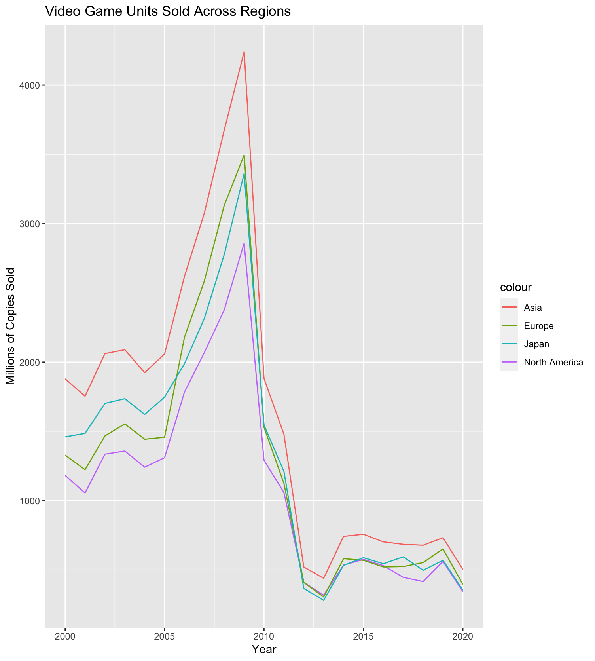
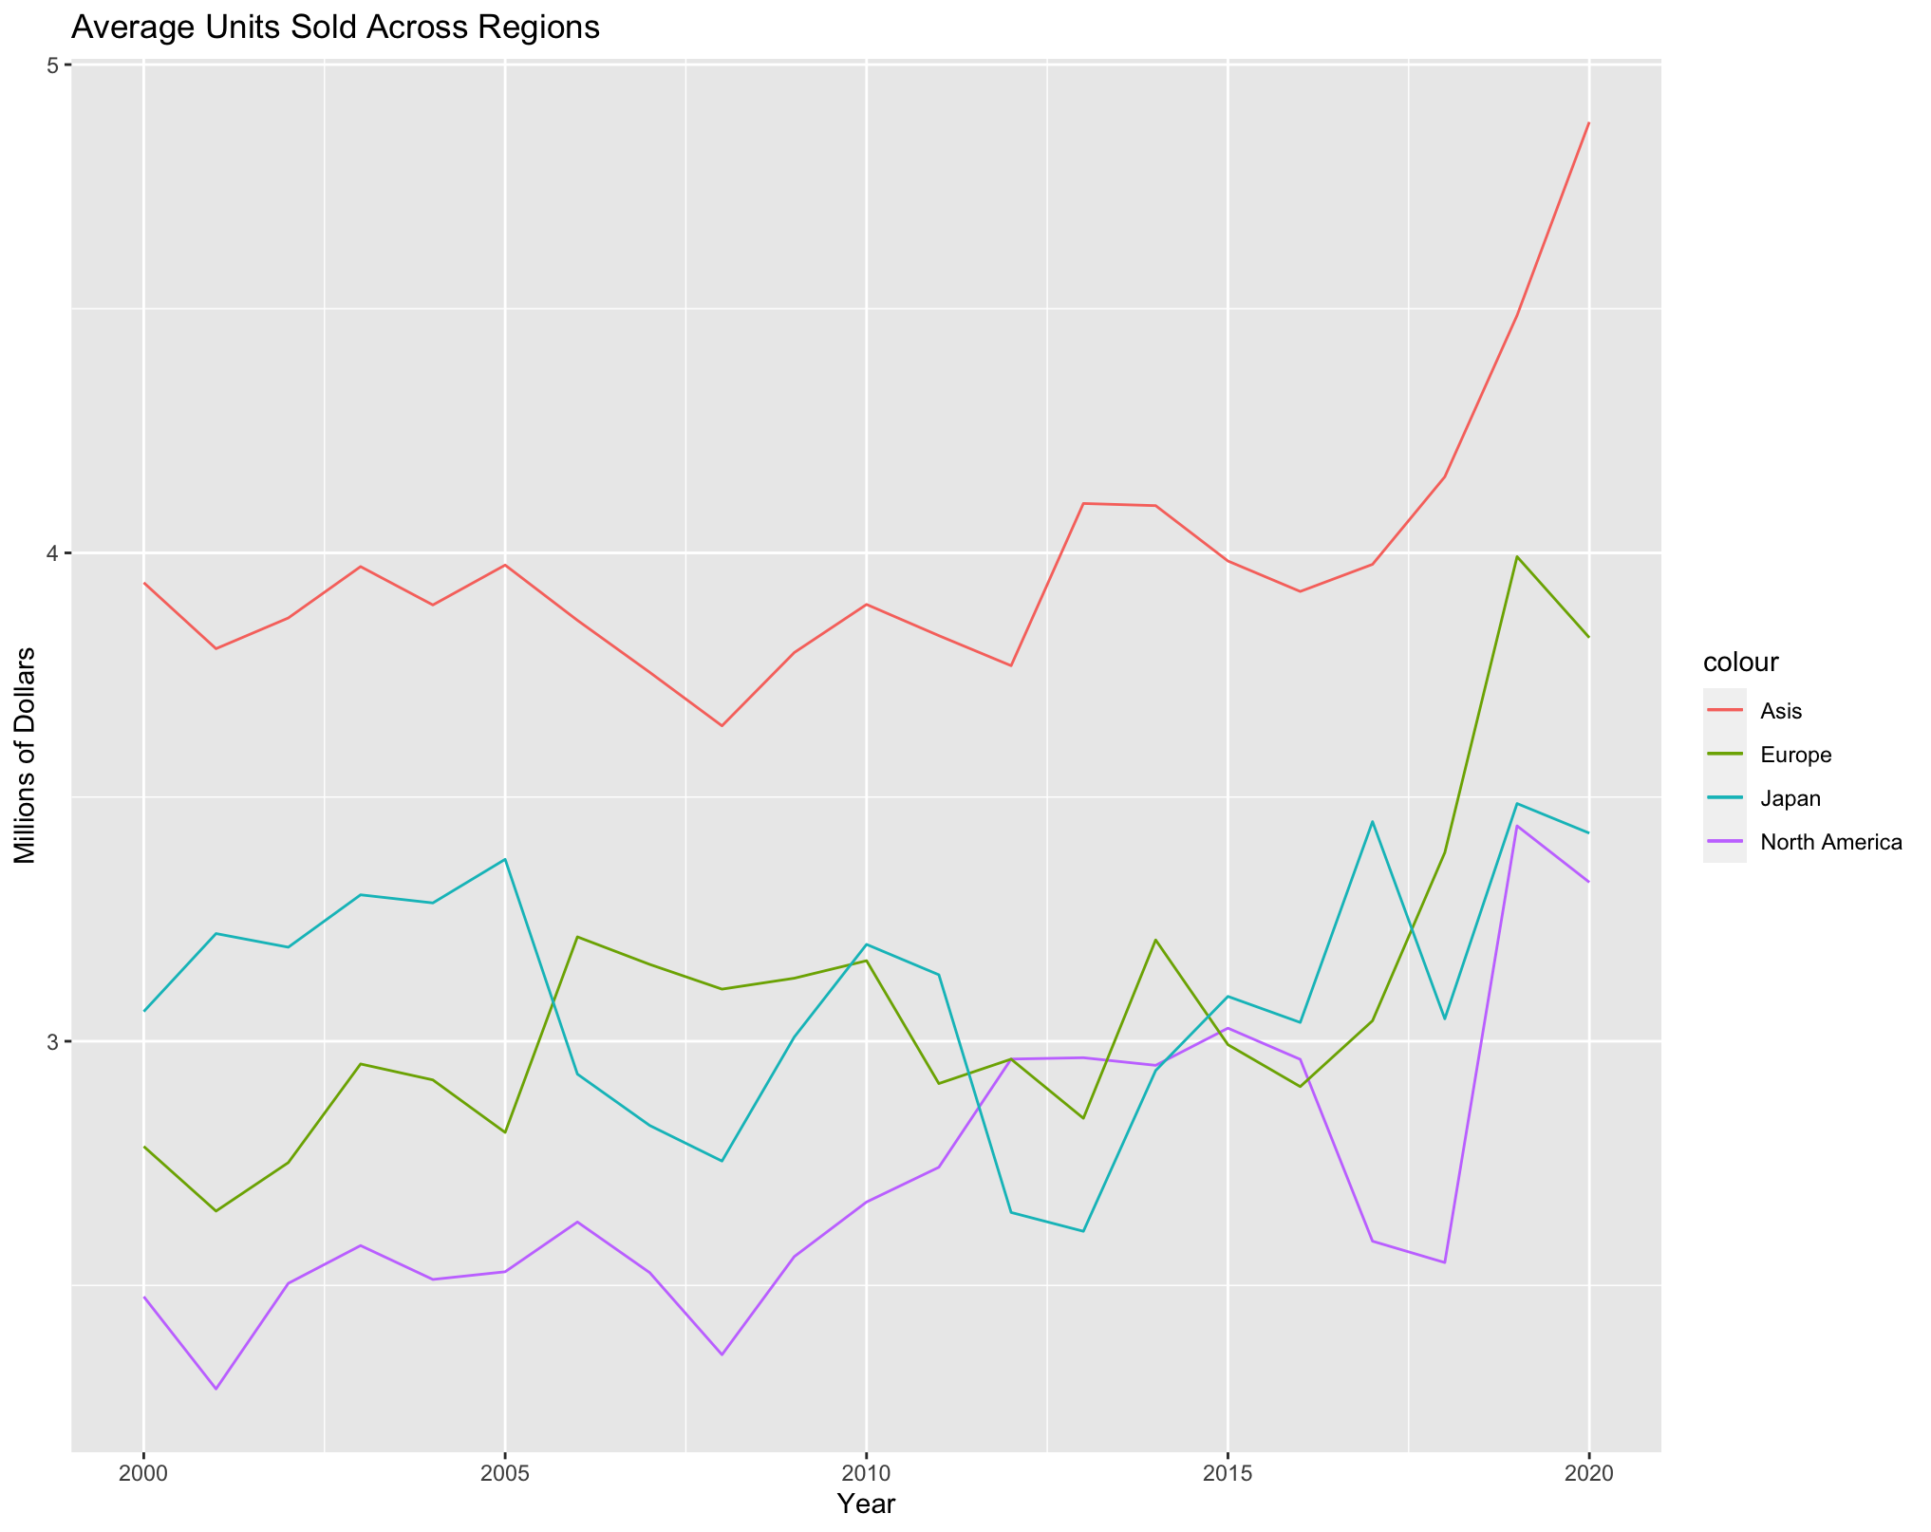
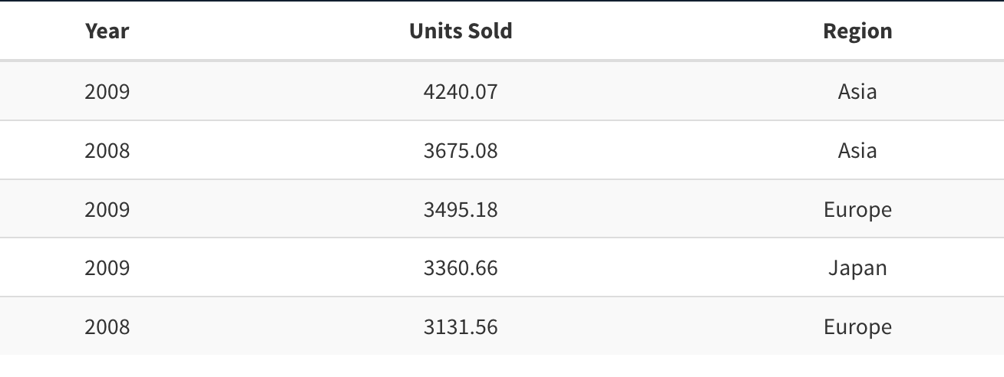
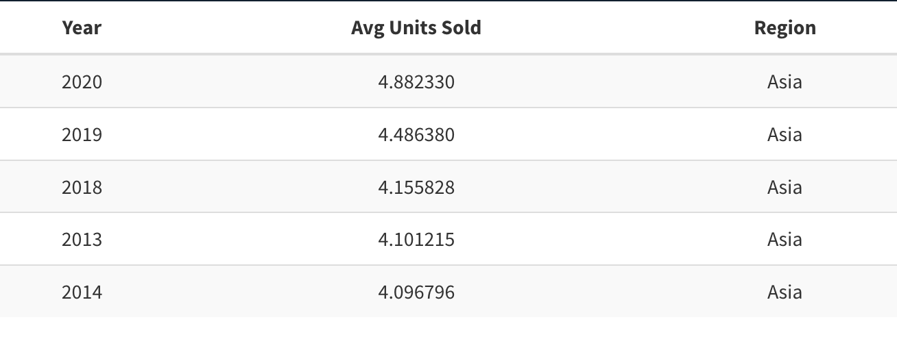
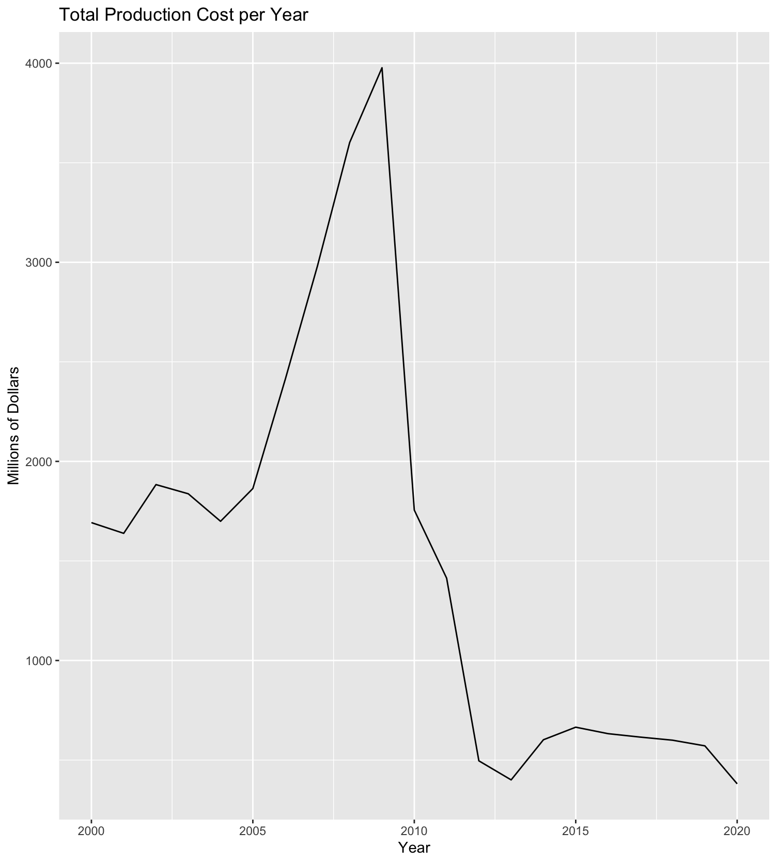
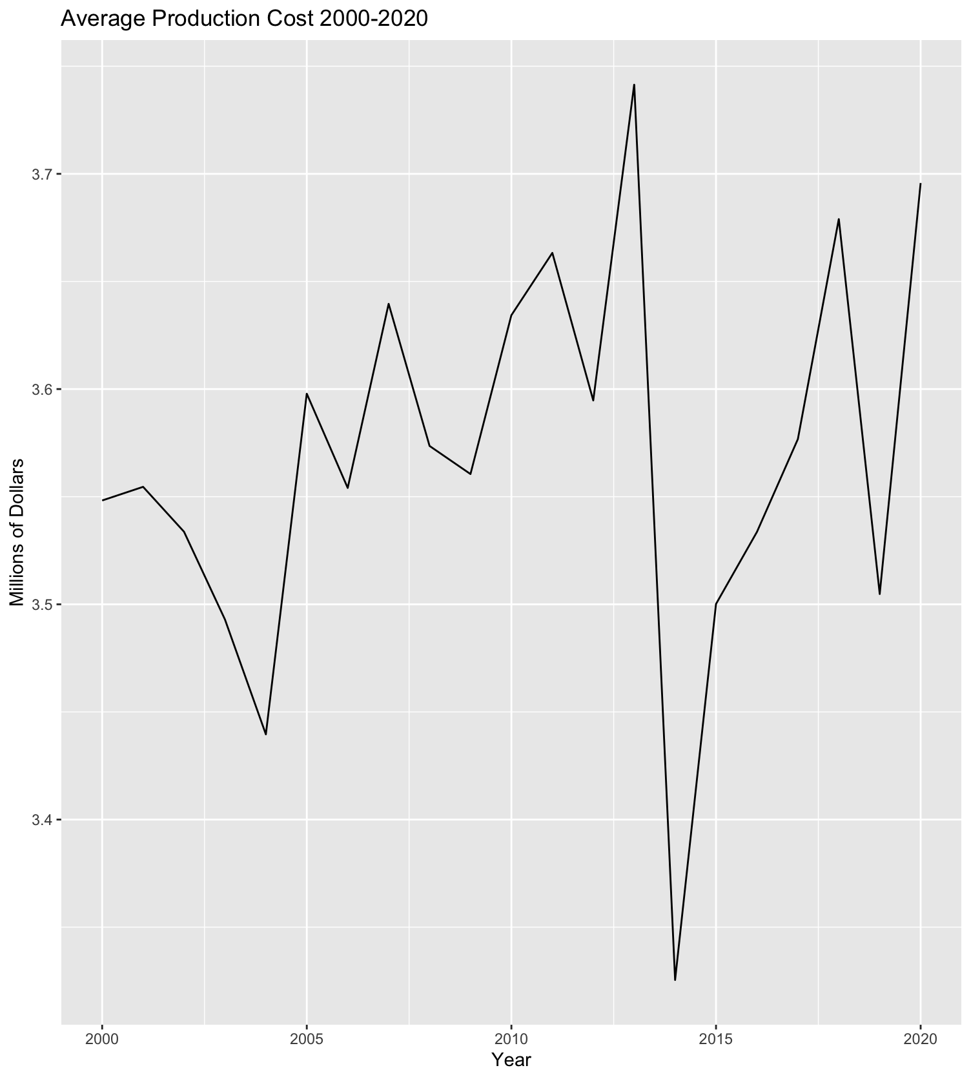
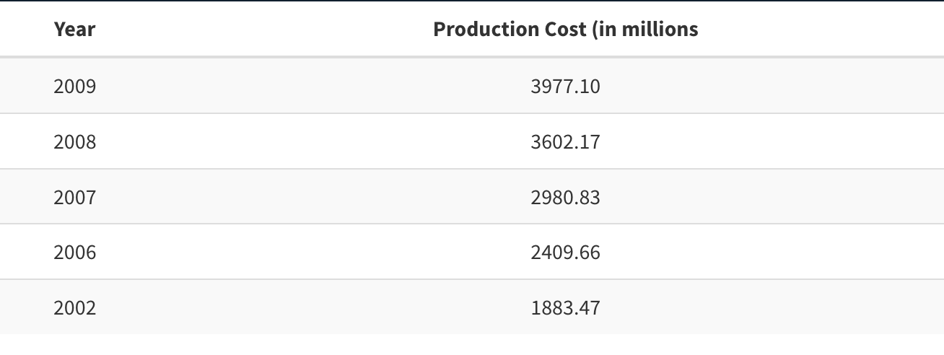
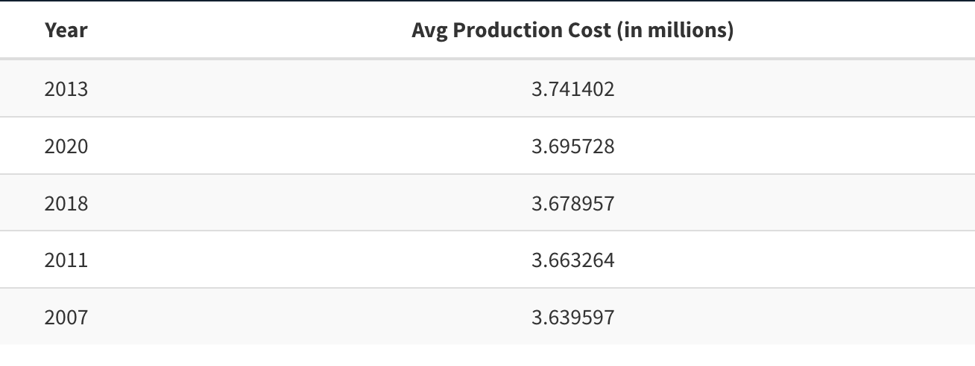
Quick Overview
Units Sold
Total
Average
Top 5 years
Years Slider
|--------------|
2000 2020
Top 5 years
Production Costs
Total
Average
Years Slider
|--------------|
2000 2020

Slide 3
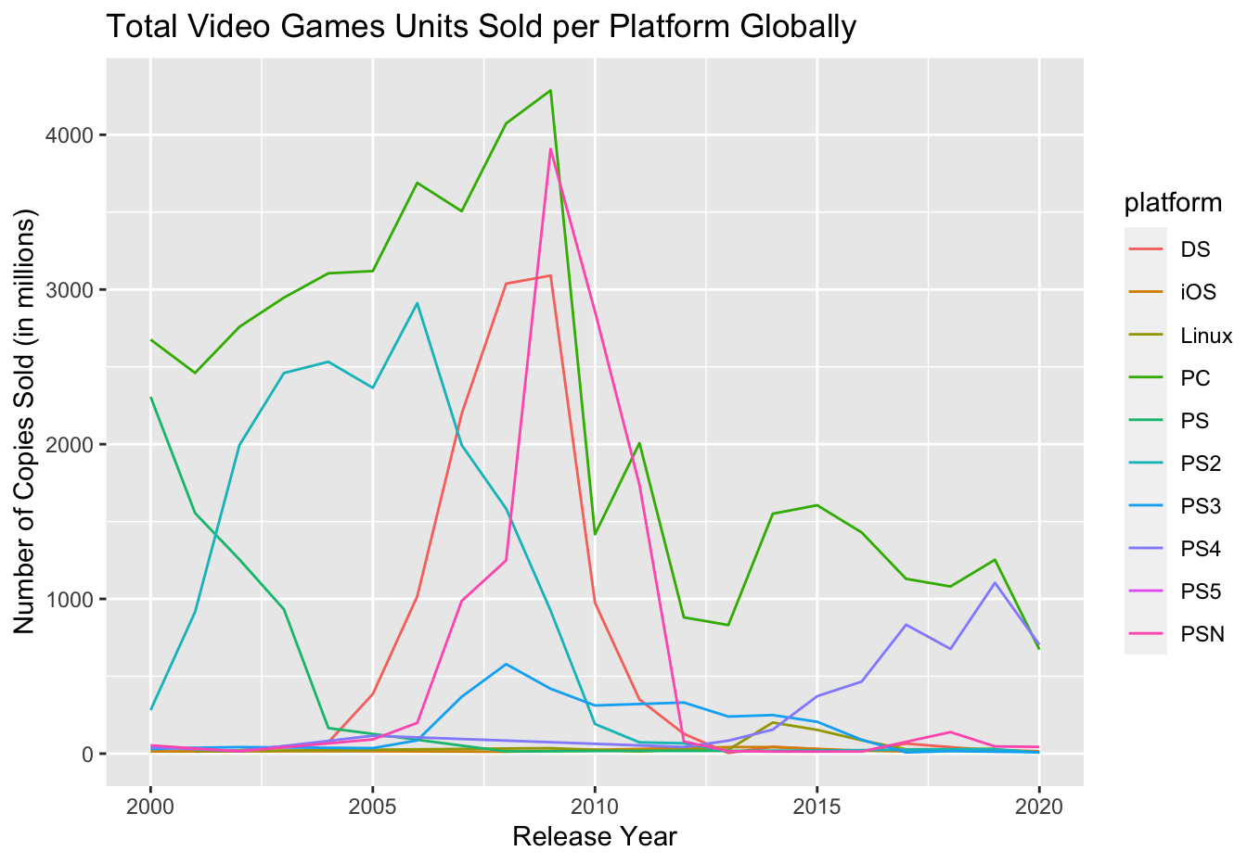
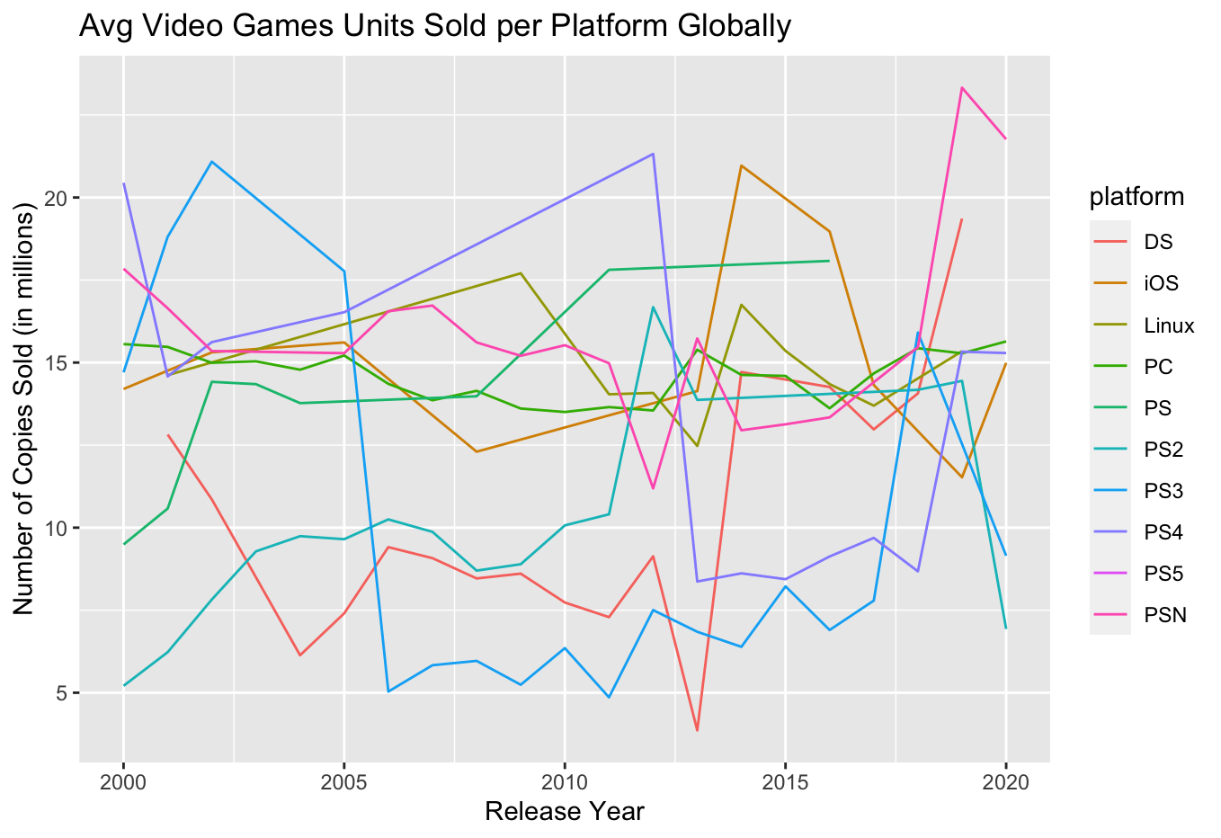
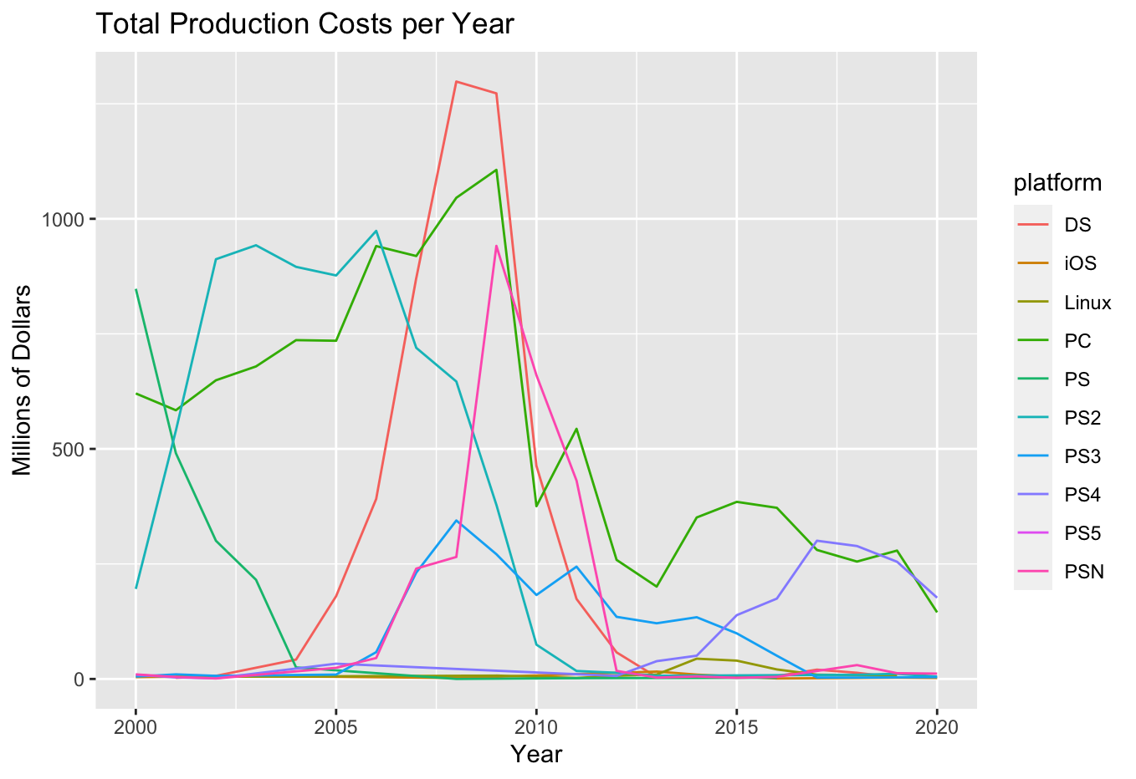
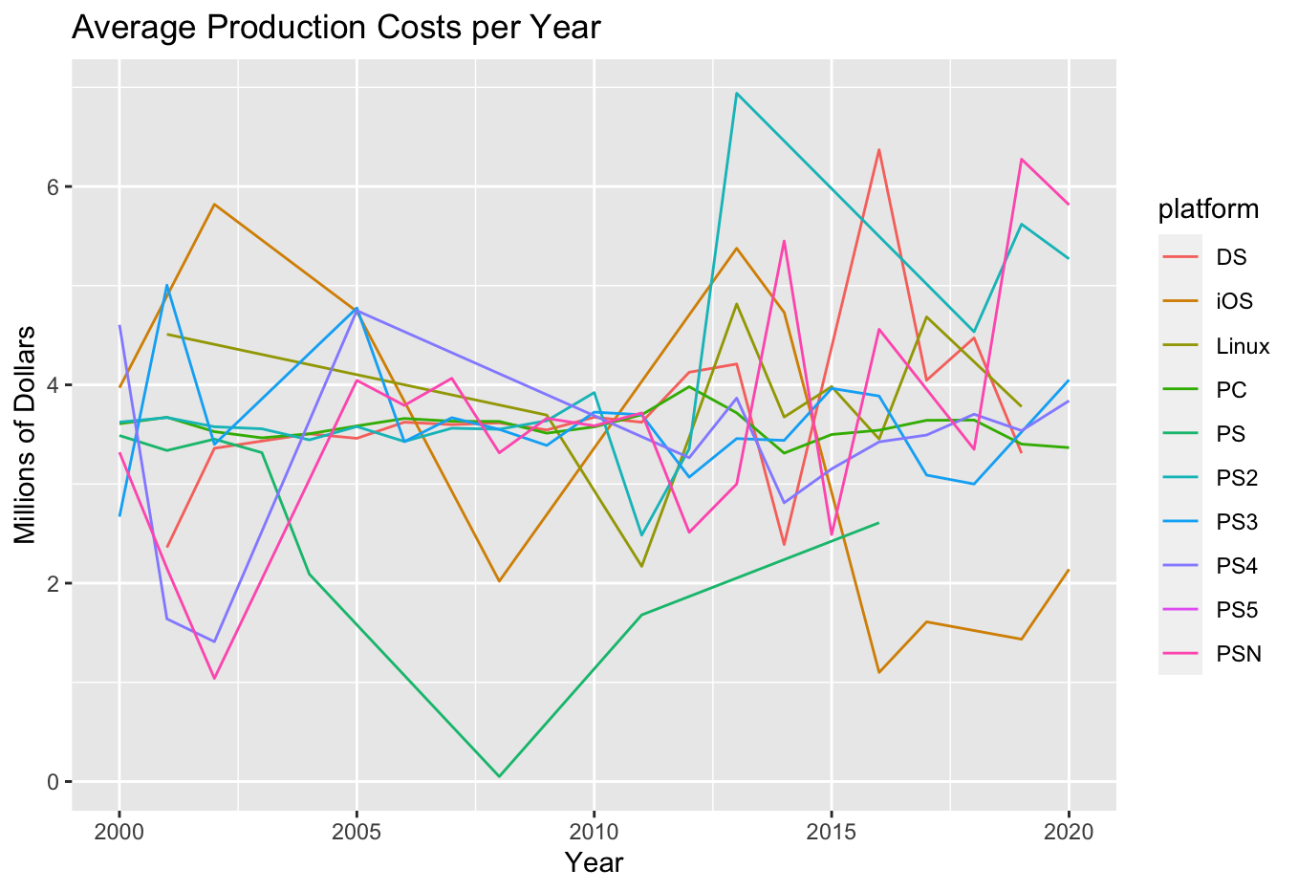
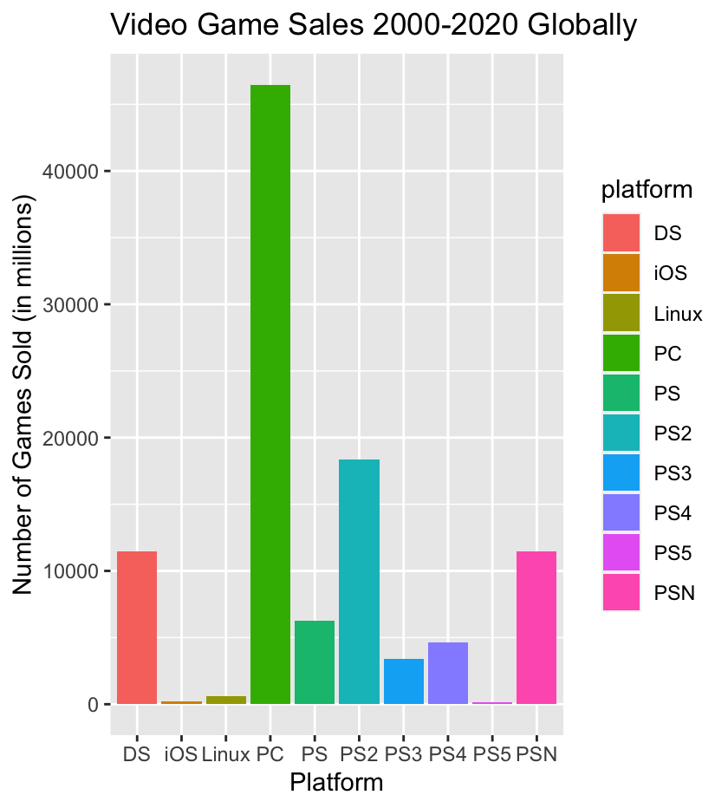
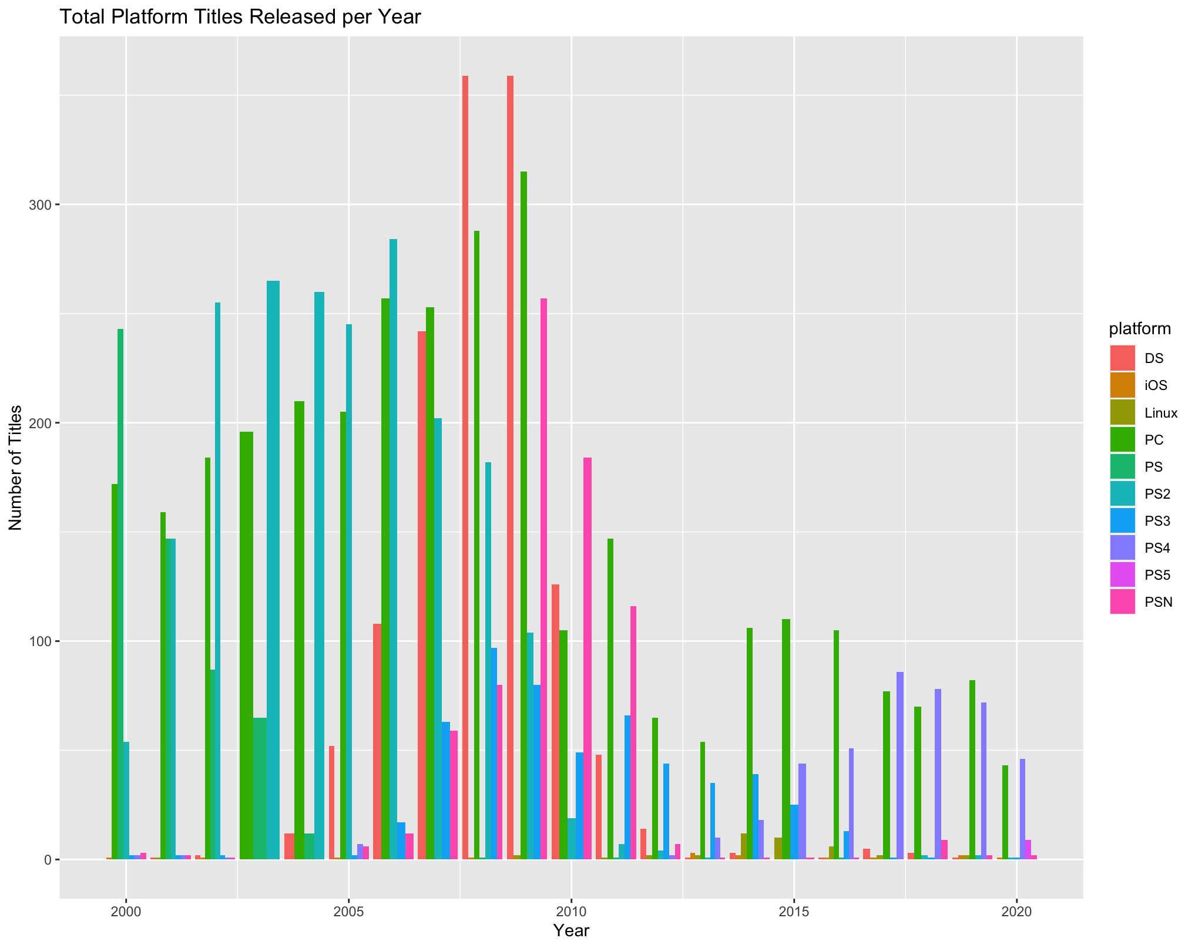
Platform
N. America | Europe | Asia | Japan
Top 5 years
Units Sold
Throughout Time
Total
average
Year | # titles sold | Platform
Years Slider
|--------------|
2000 2020
Top 5 years
Production Cost Throughout Time
Total
average
Year | production cost | Platform
Years Slider
|--------------|
2000 2020
Top 5 title sold per platform
Match region drop down
Total Units Sold per region
Global
N.America
Europe
Asia
Japan
Title | Platform
Top 5 title sold per platform
Match year
# of titles released per year
Title | Platform
Years Slider
|--------------|
2000 2020

Slide 4
Genre
Global | N. America | Europe | Asia | Japan
Top 5 years
Units Sold
Throughout Time
Year | # titles sold | Genre
Years Slider
|--------------|
2000 2020
Top 5 years
Production Cost Throughout Time
Year | production cost | Genre
Years Slider
|--------------|
2000 2020
Top 5 title sold per platform
Match region drop down
Total Units Sold per region
Global
N.America
Europe
Asia
Japan
Title | Genre
Top 5 title sold per platform
Match year
# of titles released per year
Title | Genre
Years Slider
|--------------|
2000 2020

